Slide 1
Maestro
FOTA_Boot Loader

Slide 2
Content:
1- introduction.
2-system components and main functionalities of them .
2.1.(Master MCU) MAESTRO
2.2.server
2.3.wifi module(ESP8226)
2.4. Two slaves MCUs
3-Block diagram of Flashing memories for each MCU
4-overview block diagram.
5-FOTA
5.1.Sequence of Reading hex and version files from server .
5.1.1.large hex file and limited RAM.
5.1.2.Problem Solved by using php script
6-Bootloader
7-practical part
8-Future work

Slide 3
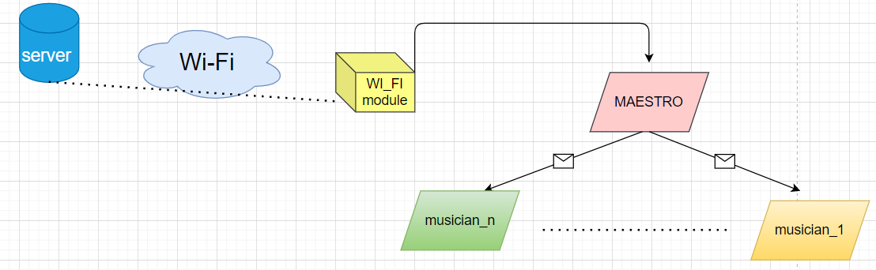
1-Introduction:
>> we called our project “MAESTRO” depends on the functionalities which provided by using this system.
>>Main idea.
>>we used some conceptects
to implement our project
Like : FOTA , Bootloader

Slide 4
2-System components and main functionalities of them:
2.1.(Master MCU) MAESTRO
>>The master MCU communicate with more than other microcontroller by using UART communication protocol.
>>Master MCU also communicates with wifi_module(ESP8266).

Slide 5
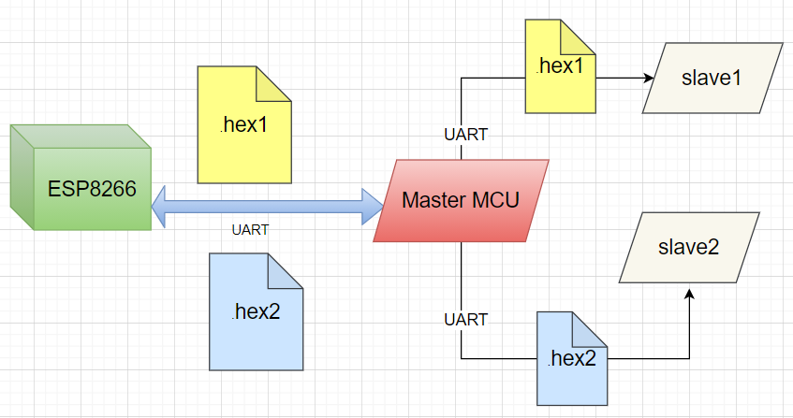
Main functionalities of Master MCU:
1_Reciving hexa files of applications that will be burned on slaves from wifi_module
and Transmitting these hex files to slaves.

Slide 6
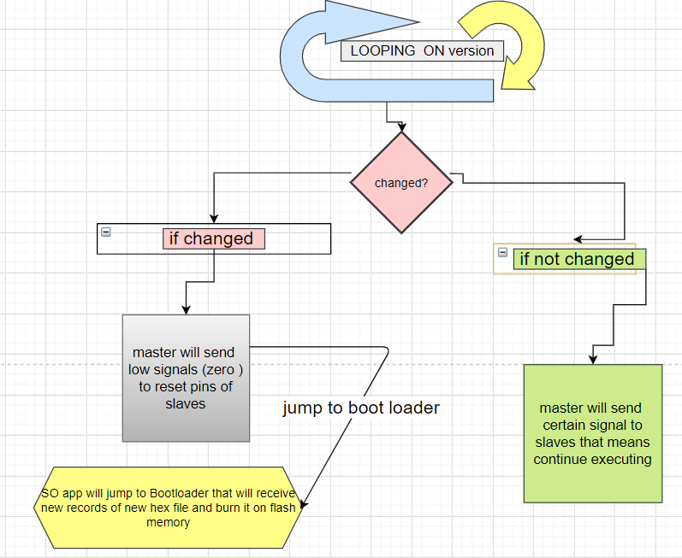
2-Check on
application versions for
any update request.

Slide 7
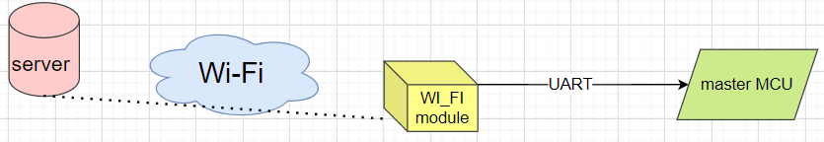
2.2.Server
>>It contains hex files of two applications and version files that indicates if there is update request or not.
2.3.WiFi module(ESP8226)
>>It receive data from server using wifi and send it to Master MCU through UART .
2.4. Two slaves MCUs
>>Each Slave MCU executes a certain application .

Slide 8
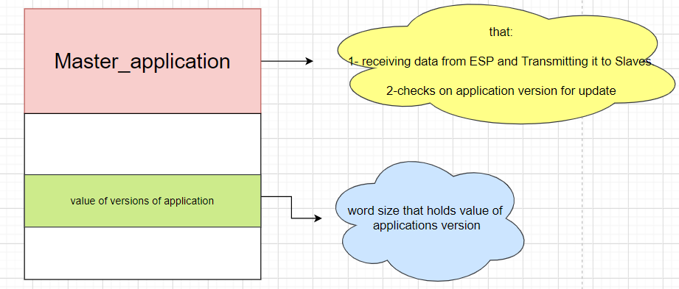
3-Block diagram of Flashing memories for each MCU:
1_Master MCU:

Slide 9
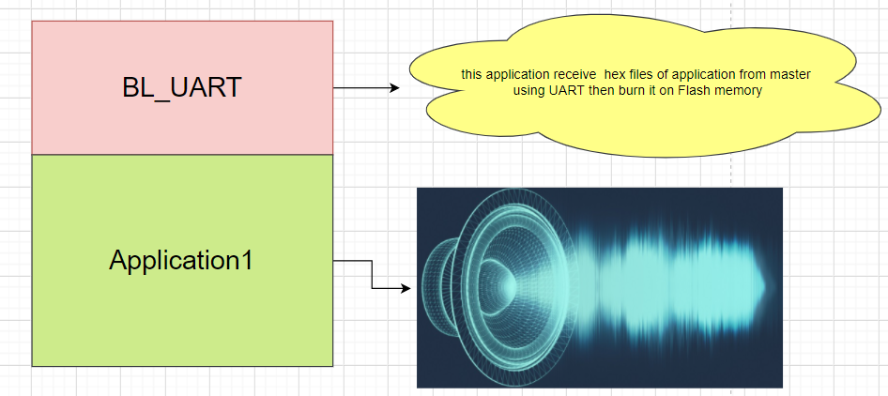
2_Slave1_ MCU:

Slide 10
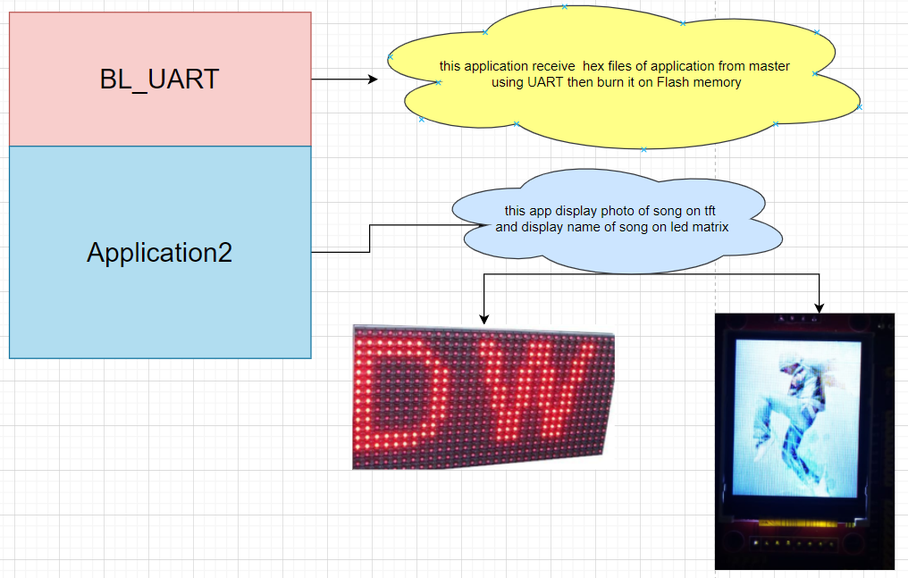
3_Slave2_ MCU:

Slide 11
4-Overview (System-BLOCK DIAGRAM)

Slide 12
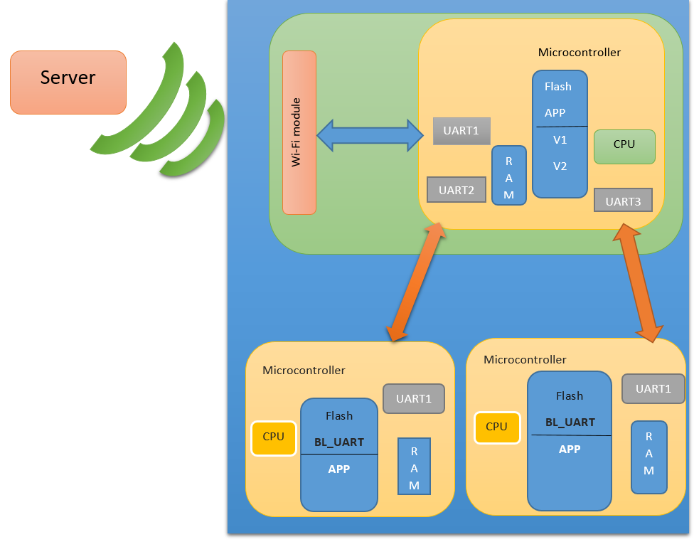



Slide 13
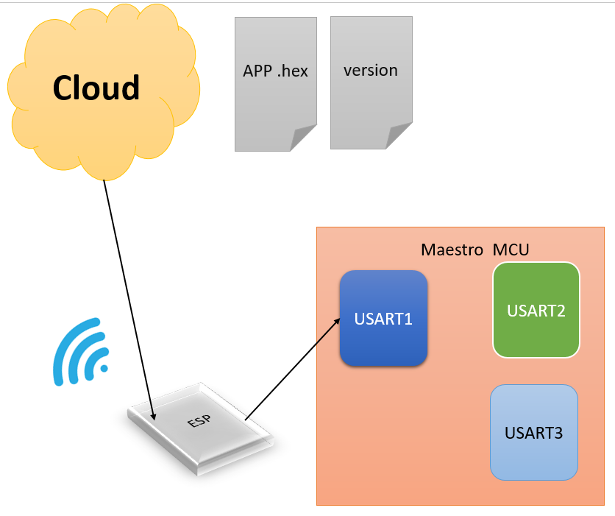
5-FOTA :
5.1.Sequence of Reading hex and version files from server .

Slide 14
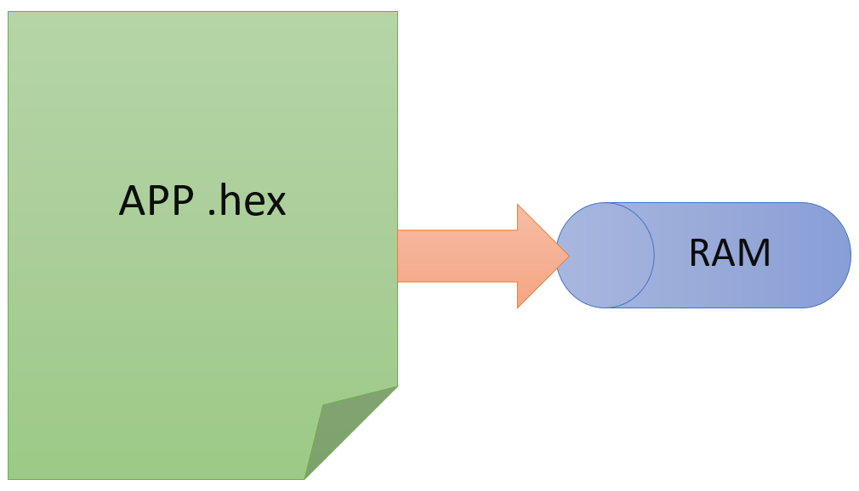
5.1.1.large hex file and limited RAM

Slide 15
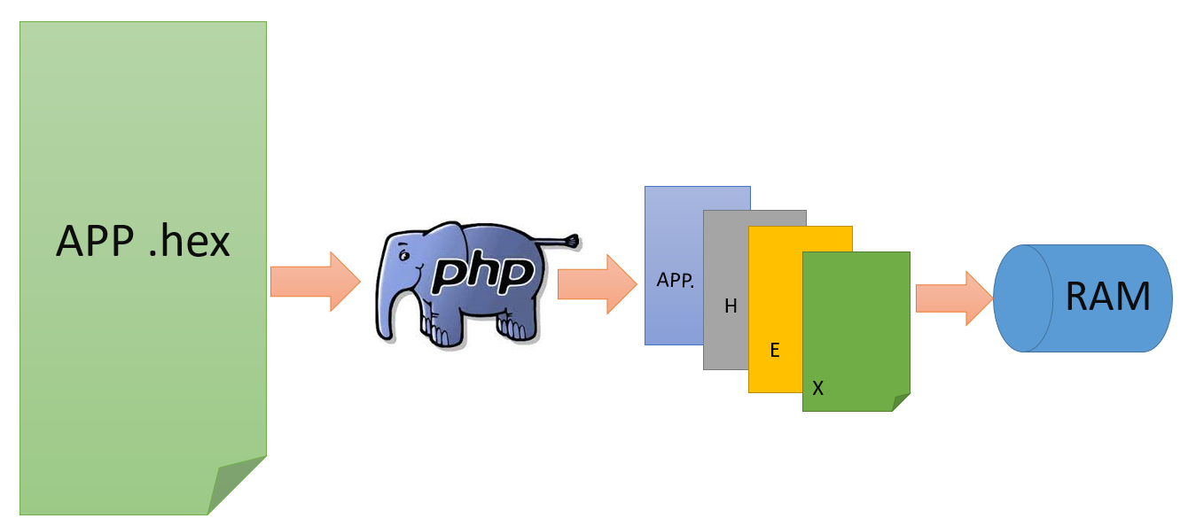
5.1.2.Problem Solved by using php script

Slide 16
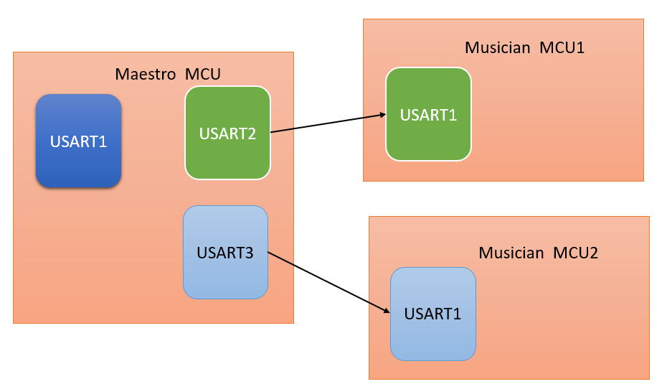
6-Bootloader:
6.1.Sequence of receiving records from maestro and burning them on flash

Slide 17
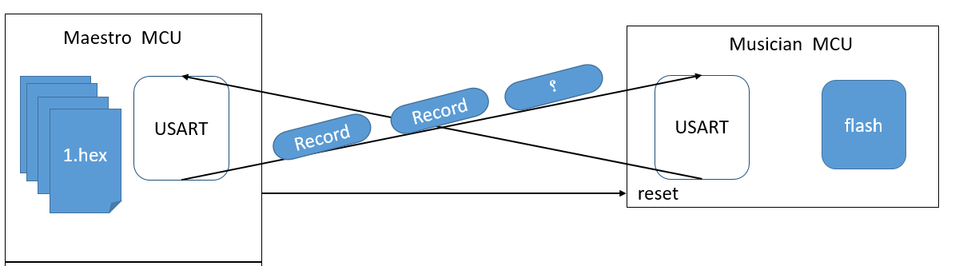
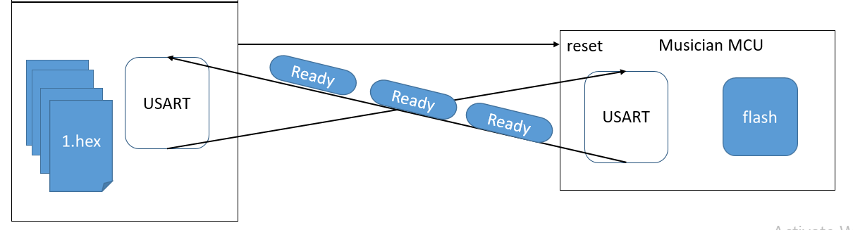

Slide 18
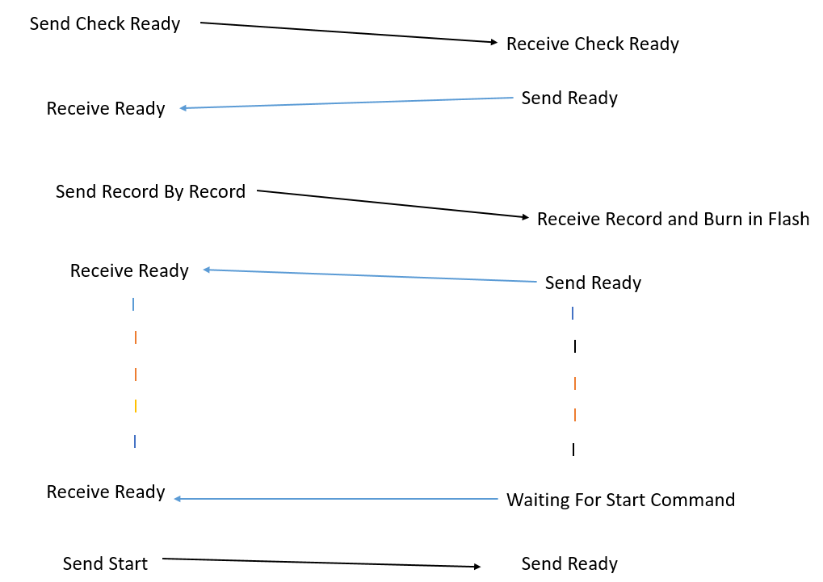

Maestro (master) musician(slave)

Slide 19
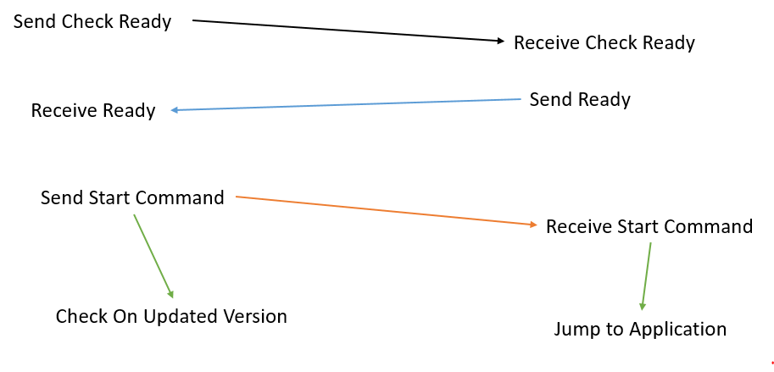
6.2.Case of power on/off applied by external source on slave:
Maestro (master) musician (slave)

Slide 20
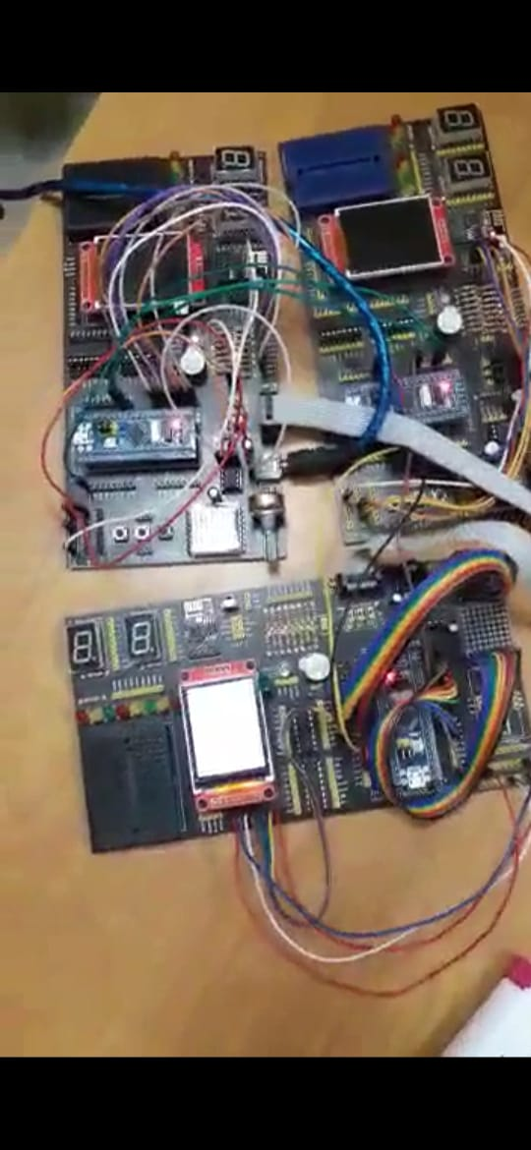
7-Let’s watch the video

Slide 21
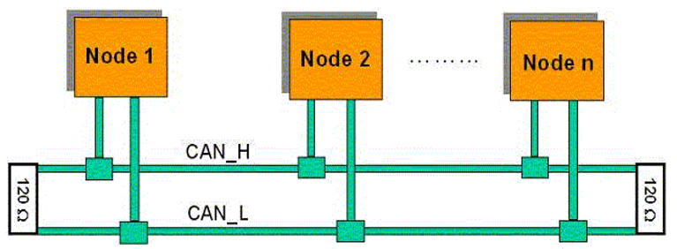
8-Future Work
8.1.CAN
We aim to change UART protocol used to connect the Nodes with each other’s with CAN protocol send and receive data over CAN bus.
We have begun to implement CAN driver.

Slide 22

8..2.SD Card
We aim to play a video on TFT so we will use an SD card to save microcontroller memory.
8..3..Real Time OS (RTOS)
We aim to change our design and divided the system into tasks, each task will have a periodicity, priority and execution time so we will use Real Time OS to achieve this. We will use FreeRTOS.

Slide 23


